Slide 1




Loan Approval Prediction
PROJECT WORK ON MACHINE LEARNING
Professor
CLAUDIO SARTORI
Presented By
Usha Padma Rachakonda(985891)

Slide 2
ABSTRACT
Loan approval is a very important process for banking organizations. The system approved or reject the loan applications. Recovery of loans is a major contributing parameter in the financial statements of a bank. It is very difficult to predict the possibility of payment of the loan by the customer. In recent years, many researchers worked on loan approval prediction systems. Machine Learning (ML)techniques are very useful in predicting outcomes for a large amount of data. In this project four machine learning algorithms, Logistic Regression(LR), Decision Tree (DT), Random Forest (RF), and XGBoost Classifier are applied to predict the loan approval of customers

Slide 3
PRESENTATION OUTLINE
Introduction
Methodology
Data Collection
Analyzing Data
Univariate Analysis
Bivariate Analysis
Data Cleaning
Missing Values Imputation
Outlier Treatment
Model Building
Logistic Regression
Decision Tree
Random Forest
XG Boost
Conclusion

Slide 4
INTRODUCTION
Now a day’s people rely on bank loans to fulfill their needs. The rate of loan applications increases at a very fast speed in recent years. Risk is always involved in the approval of loans. The banking officials are very conscious about the payment of the loan amount by its customers. Even after taking a lot of precautions and analyzing the loan applicant data, the loan approval decisions are not always correct. There is a need for automation of this process so that loan approval is less risky and less loss for banks

Slide 5
METHODOLOGY
Analyzing Data
Univariate Analysis
Bivariate Analysis
Data Cleaning
Removing Missing Values
Outlier Treatment
Model Building
Logistic Regression
XGBoost
Data Collection
Random Forest
Decision Tree
Evaluating Performance Metrics of Models
Accuracy
Precision
Recall

Slide 6
DATA COLLECTION
Data collection is the process of gathering and measuring information from countless different sources. In order to use the data, we collect to develop practical artificial intelligence (AI) and machine learning solutions
In this project the basis of the training data sets, the model will predict whether a loan would be approved or not. I have 13 features in total out of which we have 12 independent variables and 1 dependent variable i.e. Loan_Status in the training dataset and 12 independent variables in the dataset. The Loan_ID, Gender, Married, Dependents, Education, Self_Employed, Property_Area, Loan_Status are all categorical

Slide 7
ANALYSING DATA
Data analysis is defined as a process of cleaning, transforming, and modeling data to discover useful information for business decision-making.
The purpose of Data Analysis is to extract useful information from data and make the decision based On the data analysis
Data Analysis
Univariate Analysis
Bivariate Analysis

Slide 8
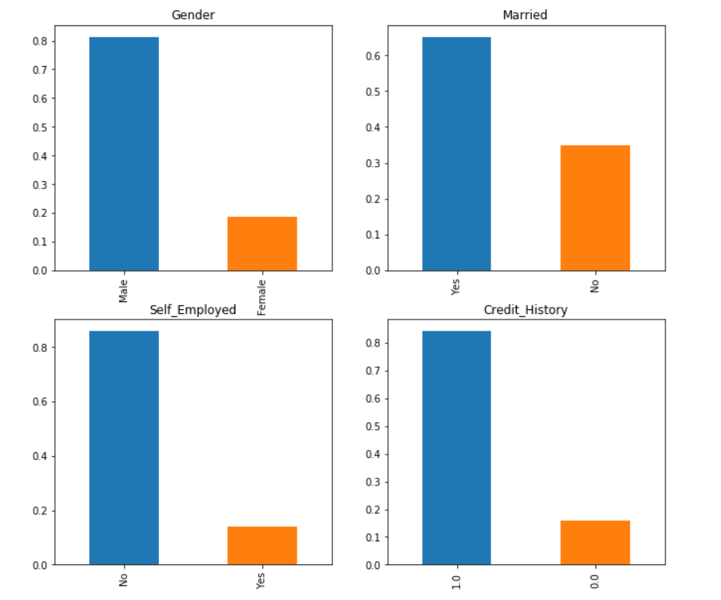
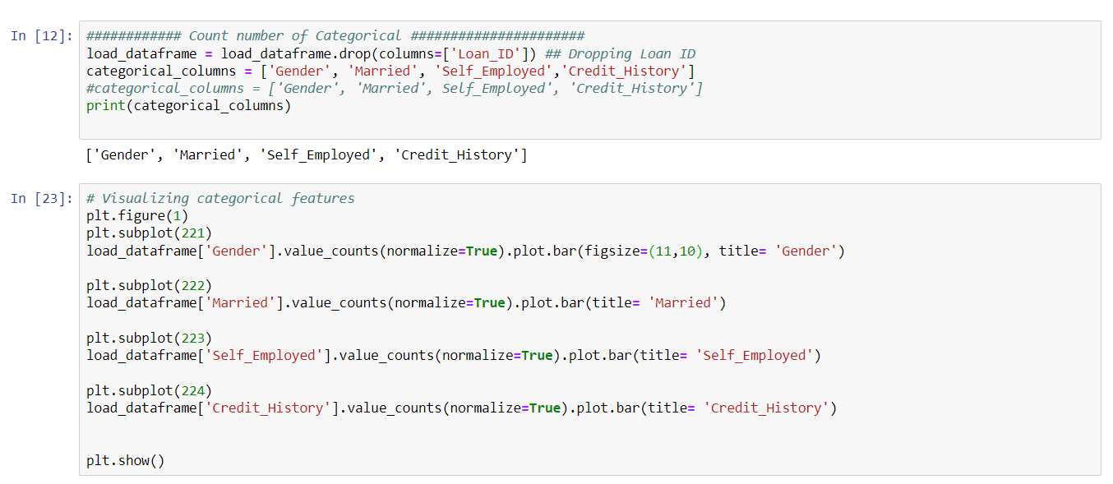
UNIVARIATE ANALYSIS
80% of loan applicants are male in the training dataset.
Nearly 70% are married
About 75% of loan applicants are graduates
Nearly 85–90% of loan applicants are self-employed
The loan has been approved for more than 65% of applicants.

Slide 9
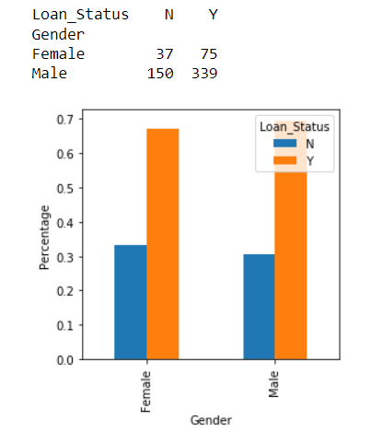
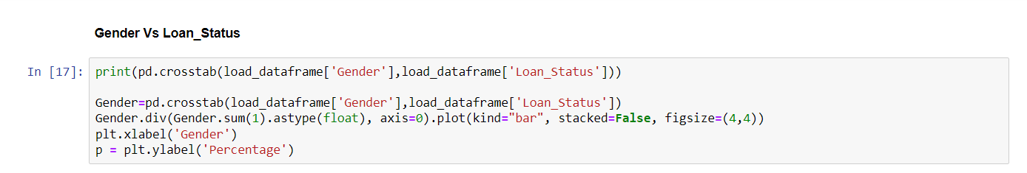
BIVARIATE ANALYSIS
Each variable will be analyzed in correlation to Loan Status.
We will check the hypothesis in this.
Categorical variables vs target variable :
There is not a substantial difference between male and female approval rates.

Slide 10
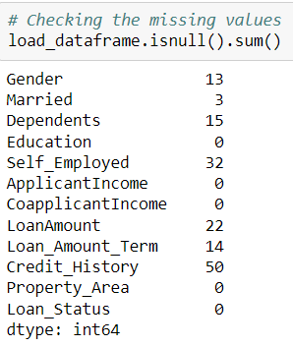
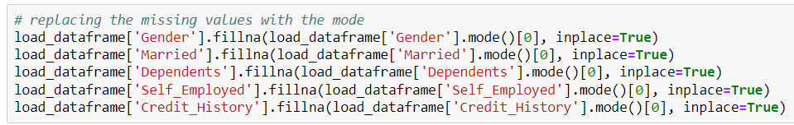
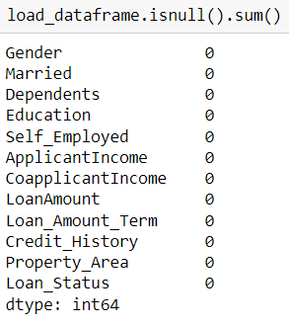
DATA CLEANING
Missing Value Imputation
For numerical variables: imputation using mean or median
For categorical variables: imputation using the mode.

Slide 11
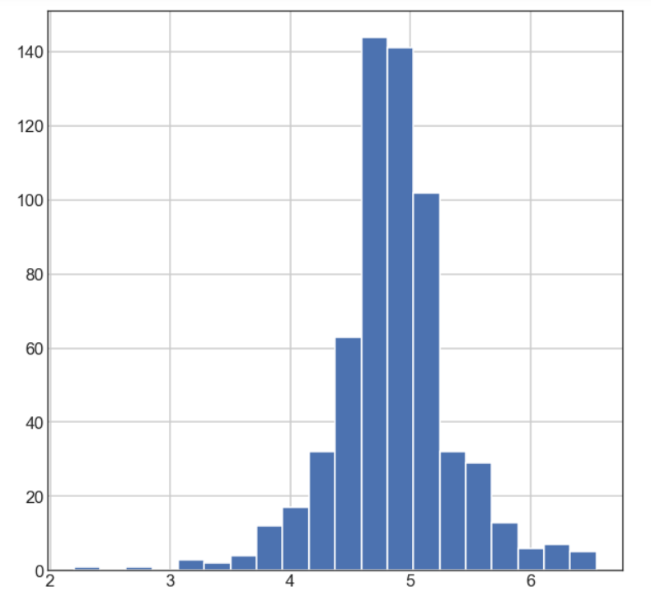
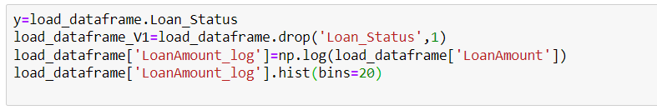
Outlier Treatment
As we take the log transformation, it does not affect the smaller values much but reduces the larger values. So, we get a distribution like a normal distribution.

Slide 12
MODEL BUILDING
A machine learning model is built by learning and generalizing from training data, then applying that acquired knowledge to new data it has never seen before to make predictions and fulfill its purpose. The following models to predict the loan approval,
Logistic Regression
Decision Tree
Random Forest
XGBOOST

Slide 13
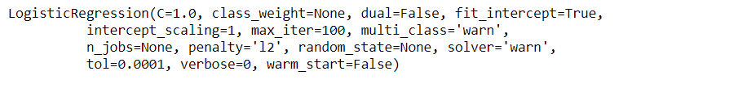
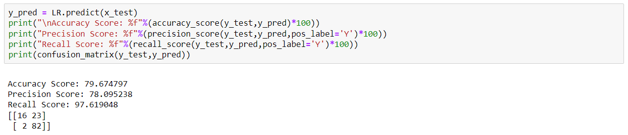
Logistic Regression:
Logistic Regression(LR)is a machine learning technique. The LR is very commonly used to solve binary classification problems.
Evaluation of Logistic Regression model:

Slide 14
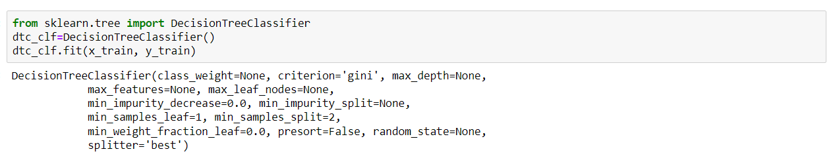
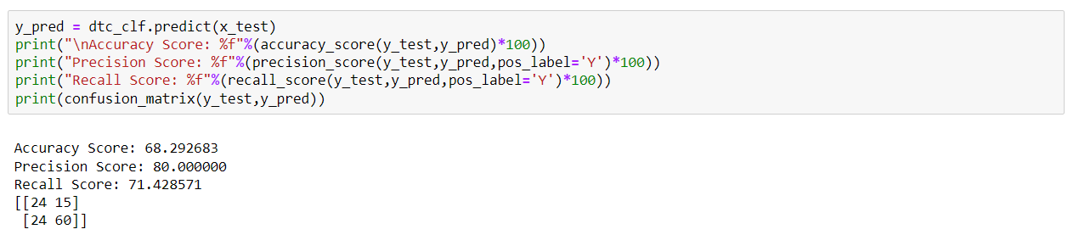
Decision Tree:
The decision tree is a supervised ML technique that is non-parametric in nature. It has a predefined target variable which is generally used in problem classification.
Evaluation of Decision Tree model:

Slide 15
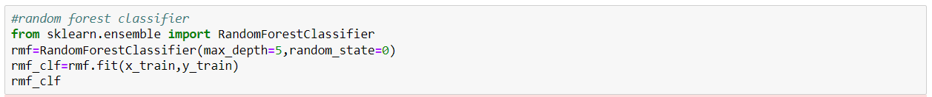
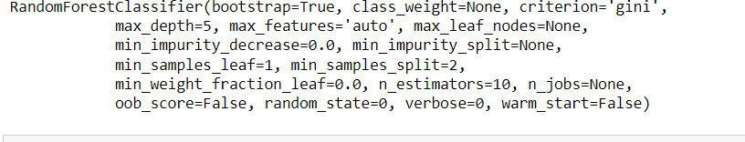
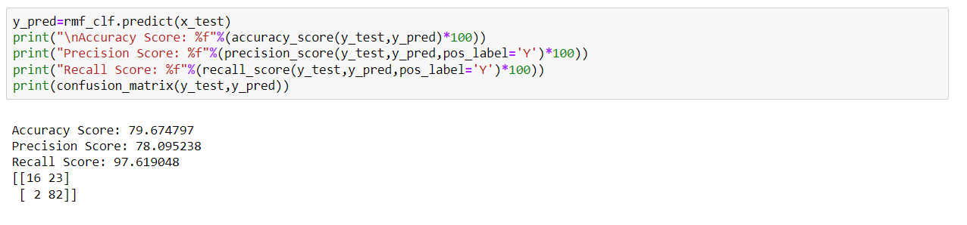
Random Forest:
Random Forest (RF) is a very useful machine learning algorithm. It is mostly used in areas such as classification, regression analysis, etc. At the training time, the RF algorithm creates many decision trees.
Evaluation of Random Forest model:

Slide 16
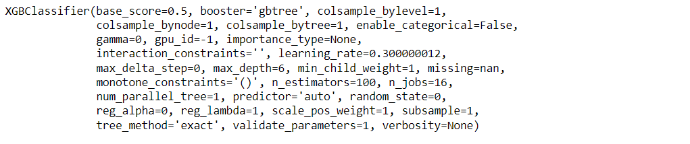
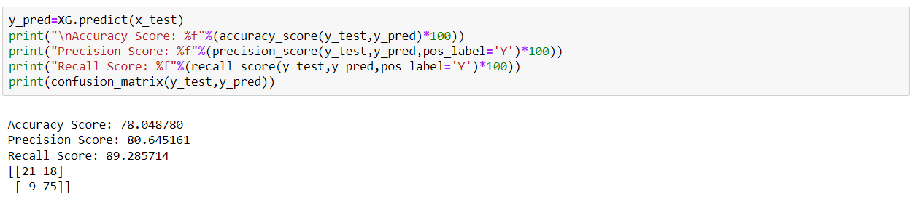
XGBOOST:
This algorithm only works with the quantitative variable. It is a gradient boosting algorithm that forms strong rules for the model by boosting weak learners to strong learners. It is a fast and efficient algorithm that recently dominated machine learning because of its high performance and speed.
Evaluation of XG Boost model:

Slide 17
CONCLUSION
Out of all the classification algorithms used on the dataset, the Logistic Regression algorithm gives the best overall prediction accuracy.
Credit History, Balance Income, Property Area were the most important factors for predicting the class of the loan applicant.
We can optimize the hyperparameters of our model and improve the accuracy.
An app with proper UI can be built, which will take various inputs from the user like income, loan amount, loan duration, etc., and give a prediction of whether their Home loan application can be approved by the banks.

Slide 18
THANK YOU

